Slide 1
Averaging Data in Molecular Dynamics
Yuan Ping

Slide 2
Outline
R. Lesar, Introduction to Computational Materials Science, ch. 6
Equilibration
Errors in averages

Slide 3
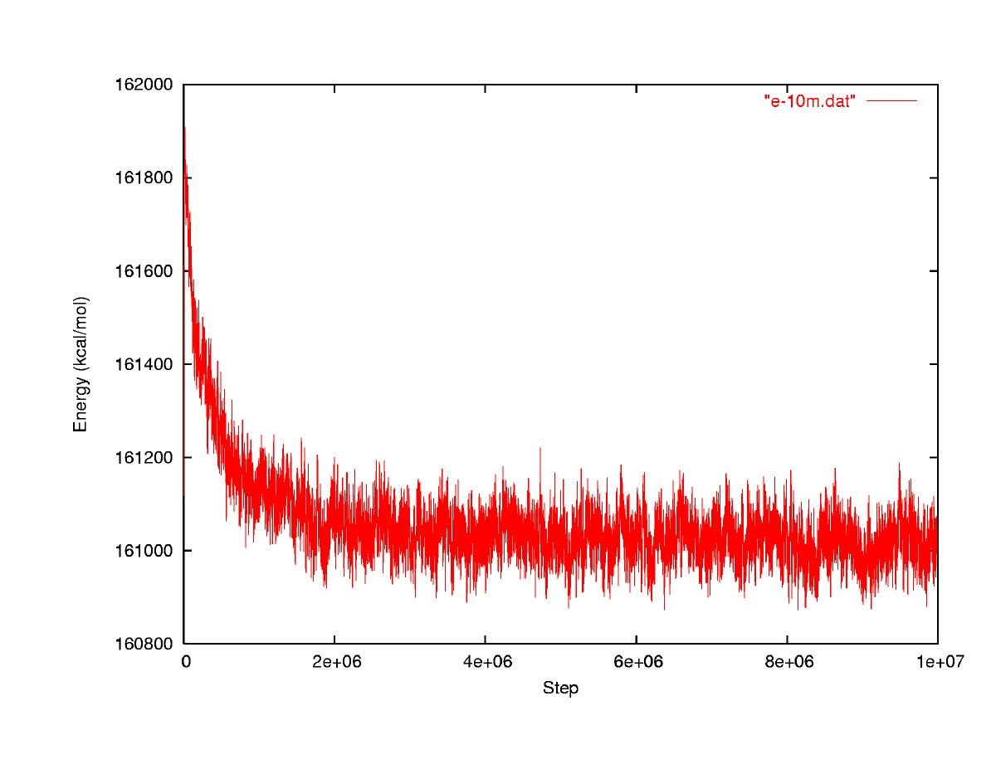
Averaging Data
How do we get a good estimate of the energy and its error from this data?
Energy
MD Step
http://mccammon.ucsd.edu/~dzhang/research/ccmv/

Slide 4
Remove Equilibration Period from Data
Equilibration period: Not equilibrated, thermal averages may be wrong
Converged: Equilibrated, thermal averages will be right
Energy
√<(δE)²>
<E>+/-σ_{<E>}
MC Step
http://mccammon.ucsd.edu/~dzhang/research/ccmv/
Can be done automatically by generally done by eye.

Slide 5
Some Definitions/Relationships
Mean of A – the best estimate for the value of A
Variance of A – square of how much A varies.
Standard deviation (or standard error) of A – measures how much A varies.
A is within +/-σ 68% of the time for normally distributed data.

Slide 6
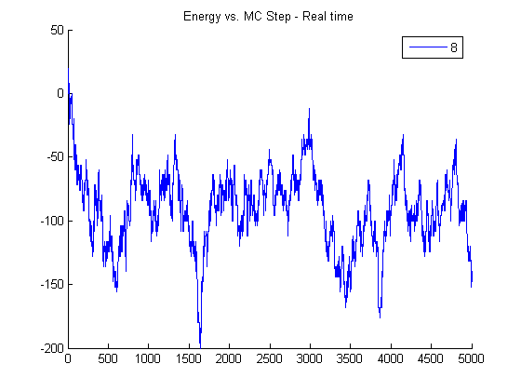
Energy Vs. MD Step
Equilibration period: Not equilibrated, thermal averages may be wrong
Equilibrated, thermal averages will be right
Energy
√<(dE)²>
Correlation length ~100-300
<E>+/-σ_{<E>}
MD Step

Slide 7
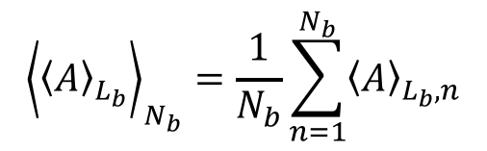
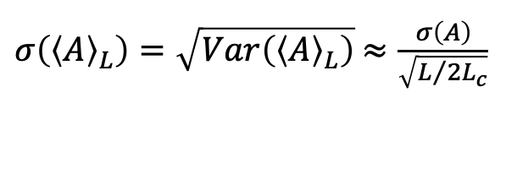
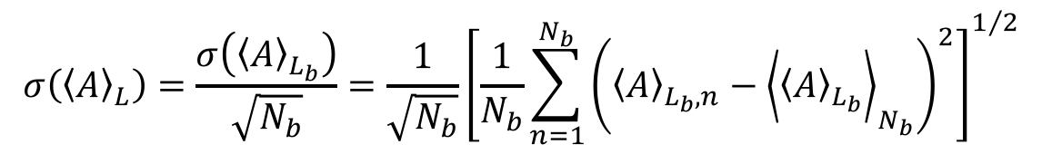
Some Definitions/Relationships
Standard error in the mean of A – measures how much <A> would vary if you redid the average (an error on your estimate <A>)
How to estimate the mean and standard error in the mean with bins (called bin averaging or block averaging)
$σ\left({\left\langle A\right\rangle }_{L}\right)=\sqrt{Var\left({\left\langle A\right\rangle }_{L}\right)}$ $≈\frac{σ\left(A\right)}{\sqrt{L/{2L_{c}}}}$
L_{c} is the correlation length, or number of steps over which your data samples are not independent
**A quantitative measure of the statistical error in a simulation is given by the variance of the mean of A
$${\left\langle {\left\langle A\right\rangle }_{L_{b}}\right\rangle }_{N_{b}}=\frac{1}{N_{b}}\sum_{n=1}^{N_{b}}{{\left\langle A\right\rangle }_{L_{b},n}}$$
$$σ\left({\left\langle A\right\rangle }_{L}\right)=\frac{σ\left({\left\langle A\right\rangle }_{L_{b}}\right)}{\sqrt{N_{b}}}=\frac{1}{\sqrt{N_{b}}}{\left[\frac{1}{N_{b}}\sum_{n=1}^{N_{b}}{{\left({\left\langle A\right\rangle }_{L_{b},n}−{\left\langle {\left\langle A\right\rangle }_{L_{b}}\right\rangle }_{N_{b}}\right)}^{2}}\right]}^{1/2}$$
Must take bins > correlation length so they are independent samples.

Slide 8
Block (Bin) Averaging to Get Error in <E>
Equilibration period
Bin 1
Bin 2
Bin 3
Bin 4
Energy
<E>+/-σ_{<E>}
<E>_{bin}
MD Step
Must take bins > correlation length so they are independent samples.

Slide 9
Summary
Always remove initial steps to be sure your system is equilibrated if you want a steady state average.
Errors for averages include both standard deviation of the data and standard deviation in the mean, and it is usually the latter you want.
Use block (bin) averaging to get an upper bound estimate.

Slide 10
Backup

Slide 11
An Exact Expression for Error in <A>_{L}
What is the statistical error in <A>_{L} vs. L?
For uncorrelated data
But MD steps are correlated, so we need more thorough statistics
V_{l} is the covariance and gives the autocorrelation of A with itself l steps later .
Longer correlation length ⇒ less independent data ⇒ Less accurate <A>. This expression can be hard to converge reliably.

